Slide 1
SDLC lifecycle
Velocity Training Institute
Shantanu Mahajan (sr Engg Devops)

Slide 2
Types of Software companies
Service Based Companies :-
These companies provides services by means of business consulting, information technology, software engineering and outsourcing.
Top Companies : TCS, Infosys, Wipro, Accenture, Tech Mahindra, CTS and etc.
Product Based companies:-
These companies have a product or a set of products that provides for a major portion of the revenue.
Top Companies: Amazon, Microsoft, Cisco, Google etc.

Slide 3
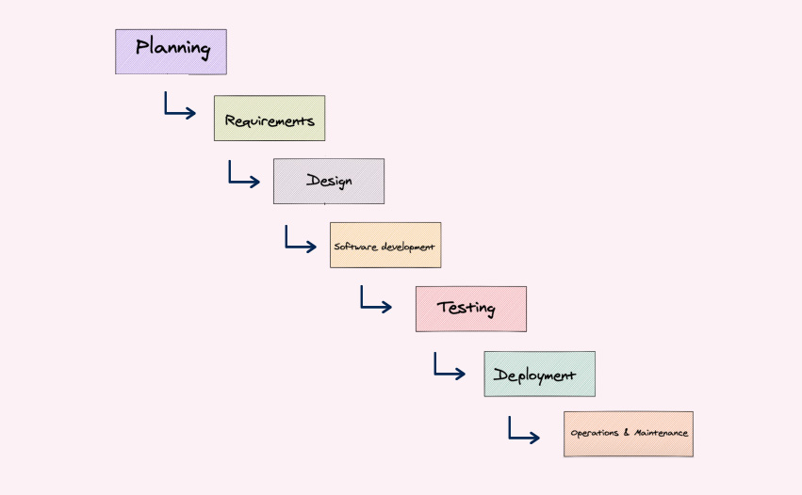
SDLC lifecycle

Slide 4
Types of sdlc models
Waterfall Model
Spiral Model
V Model
Agile
Hybrid Model

Slide 5
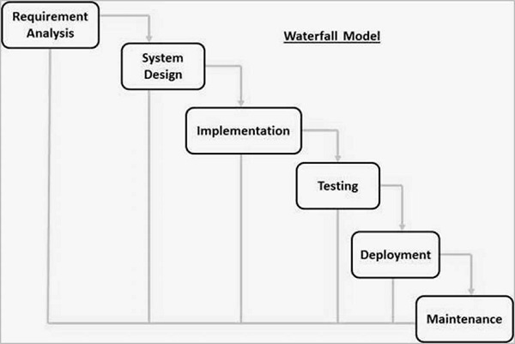
Waterfall model

Slide 6
Advantages and disadvantages of waterfall model
ADVANTAGES
Simple and easy to understand and use.
Easy to manage.
Phases are processed and completed one at a time.
Client requirements are very well understood.
Clearly defined stages
DISADVANTAGES
No working software is produced until the implementation stage which is too late in the SDLC.
High amount of risk.
Not good for complex projects
Poor model for large and ongoing projects.

Slide 7
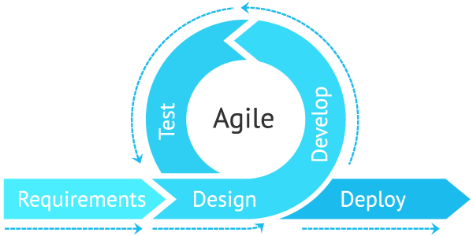
Agile model
A large project is broke down into small chunks, developed and released to the market asap.
Once the project is released, based on the feedback/response of the customers a new iteration/version of the project is re-released.

Slide 8
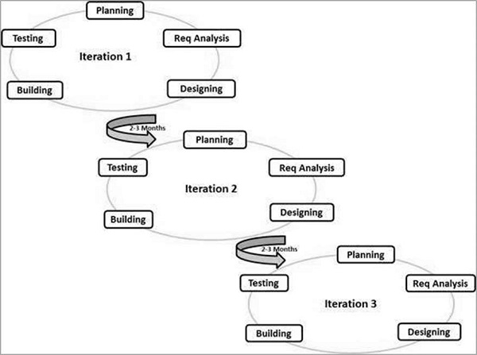

Slide 9
Advantages and disadvantages of agile
ADVANTAGES
Frequent delivery
More interaction with clients as feedback based approach.
Changes/updates in software product are more.
Time to market is less
DISADVANTAGES
Less documentation
Maintenance of all the versions/iterations is difficult

Slide 10
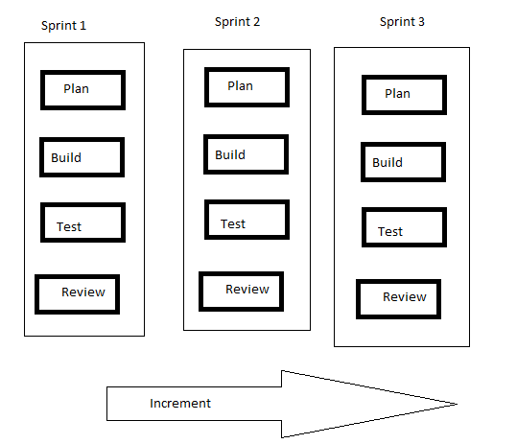
Scrum
Implementation of agile is scrum
In scrum we have a concept known as sprint which is a phase which may last 2-3 weeks.
In each sprint cycle, just enough planning is done to get started with and simultaneously the code is built, tested and reviewed.

Slide 11
Roles, artifacts and ceremonies
Roles
Product Owner
Business Analyst
Scrum Master
Scrum Team
Artifacts
Product Backlog:- Prioritized list of Features or user stories.
User stories:- Way of describing a Features
Sprint Backlog:- High Priority user story go into the sprint.
Ceremonies
Sprint Planning
Daily Scrum call
Sprint Review and Retrospective

Slide 12
devops
Devops ideology promotes fast software development i.e time to market or customer is less.
The only difference between agile and devops is what happens after development.
Agile is limited up to development, testing and deployment.
The operations is not included or you can say not focused in agile, whereas in devops the operation part of the SDLC lifecycle comes into picture.

Slide 13
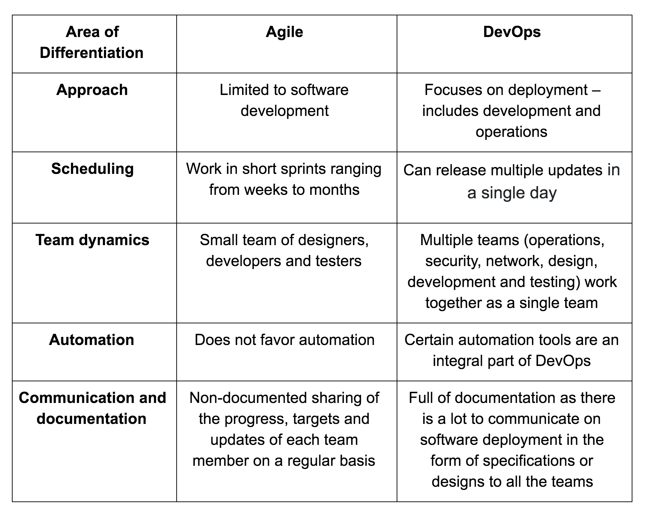

Slide 14
